Slide 1
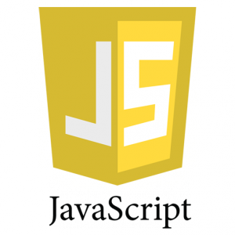
JavaScript- Introduction

Slide 2
JavaScript- Introduction
JavaScript is a solution of client side dynamic pages.
JavaScript is an object-based scripting language that is lightweight and cross-platform.
JavaScript is not compiled but translated.
The JavaScript Translator (embedded in browser) is responsible to translate the JavaScript code.
Where JavaScript is used
JavaScript is used to create interactive websites. It is mainly used for:
  Client-side validation
  Dynamic drop-down menus
  Displaying data and time
  Displaying popup windows and dialog boxes (like alert dialog box, confirm dialog box and prompt dialog box)
  Displaying clocks etc.

Slide 3
JavaScript- Introduction
JavaScript is a programming language that adds interactivity to your website (for example: games, responses when buttons are pressed or data entered in forms, dynamic styling, animation).
JavaScript ("JS" for short) is a full-fledged dynamic programming language that, when applied to an HTML document, can provide dynamic interactivity on websites. It was invented by Brendan Eich, co-founder of the Mozilla project, the Mozilla Foundation, and the Mozilla Corporation.
JavaScript is incredibly versatile. You can start small, with carousels, image galleries, fluctuating layouts, and responses to button clicks. With more experience, you'll be able to create games, animated 2D and 3D graphics, comprehensive database-driven apps, and much more!

Slide 4
JavaScript- Introduction
JavaScript itself is fairly compact yet very flexible. Developers have written a large variety of tools on top of the core JavaScript language, unlocking a vast amount of extra functionality with minimum effort. These include:
  Browser Application Programming Interfaces (APIs) — APIs built into web browsers, providing functionality like dynamically creating HTML and setting CSS styles, collecting and manipulating a video stream from the user's webcam, or generating 3D graphics and audio samples.
  Third-party APIs to allow developers to incorporate functionality in their sites from other content providers, such as Twitter or Facebook.
  Third-party frameworks and libraries you can apply to your HTML to allow you to rapidly build up sites and applications.
JavaScript Example
<h2>Welcome to JavaScript</h2>
<script>
document.write("Hello JavaScript by JavaScript");
</script>

Slide 5
JavaScript Example
JavaScript easy to code.
Let’s create the first JavaScript example.
<script type="text/javascript">
document.write("JavaScript is a simple language for java learners");
</script>
The script tag specifies that we are using JavaScript.
The text/javascript is the content type that provides information to the browser about the data.
The document.write() function is used to display dynamic content through JavaScript.

Slide 6
3 Places to put JavaScript code
Between the body tag of html
Between the head tag of html
In .js file (external JavaScript)
1) JavaScript Example : code between the body tag
In the above example, we have displayed the dynamic content using JavaScript.
Let’s see the simple example of JavaScript that displays alert dialog box.
<script type="text/javascript">
alert("Hello JavaScript");
</script>

Slide 7
2) code between the head tag
Let’s see the same example of displaying alert dialog box of JavaScript that is contained inside the head tag.
In this example, we are creating a function msg(). To create function in JavaScript, you need to write function with function name as given below.
To call function, you need to work on event. Here we are using onclick event to call msg() function.
<html>
<head>
<script type="text/javascript">
function msg(){
alert("Hello JavaScript");
}
</script>
</head>
<body>
<p>Welcome to JavaScript</p>
<form>
<input type="button" value="click" onclick="msg()"/>
</form>
</body>
</html>

Slide 8
3. External JavaScript file
We can create external JavaScript file and embed it in many html page.
It provides code re usability because single JavaScript file can be used in several html pages.
An external JavaScript file must be saved by .js extension. It is recommended to embed all JavaScript files into a single file. It increases the speed of the webpage.
Let’s create an external JavaScript file that prints Hello JavaScript in a alert dialog box.
message.js
function msg(){
alert("Hello JavaScript");
}
Let’s include the JavaScript file into html page. It calls the JavaScript function on button click.
index.html
<html>
<head>
<script type="text/javascript" src="message.js"></script>
</head>
<body>
<p>Welcome to JavaScript</p>
<form>
<input type="button" value="click" onclick="msg()"/>
</form>
</body>
</html>

Slide 9
JavaScript Comments
The JavaScript comments are meaningful way to deliver message. It is used to add information about the code, warnings or suggestions so that end user can easily interpret the code.
The JavaScript comment is ignored by the JavaScript engine i.e. embedded in the browser.
Advantages of JavaScript comments
There are mainly two advantages of JavaScript comments.
To make code easy to understand It can be used to elaborate the code so that end user can easily understand the code.
To avoid the unnecessary code It can also be used to avoid the code being executed. Sometimes, we add the code to perform some action. But after sometime, there may be need to disable the code. In such case, it is better to use comments.

Slide 10
Types of JavaScript Comments
There are two types of comments in JavaScript.
Single-line Comment
Multi-line Comment
JavaScript Single line Comment
It is represented by double forward slashes (//). It can be used before and after the statement.
Let’s see the example of single-line comment i.e. added before the statement.
<script>
// It is single line comment
document.write("hello javascript");
</script>
Let’s see the example of single-line comment i.e. added after the statement.
<script>
var a=10;
var b=20;
var c=a+b;//It adds values of a and b variable
document.write(c);//prints sum of 10 and 20
</script>

Slide 11
JavaScript Multi line Comment
It can be used to add single as well as multi line comments. So, it is more convenient.
It is represented by forward slash with asterisk then asterisk with forward slash. For example:
/* your code here */
It can be used before, after and middle of the statement.
<script>
/* It is multi line comment.
It will not be displayed */
document.write("example of javascript multiline comment");
</script>

Slide 12
JavaScript variable
A JavaScript variable is simply a name of storage location. There are two types of variables in JavaScript : local variable and global variable.
There are some rules while declaring a JavaScript variable (also known as identifiers).
Name must start with a letter (a to z or A to Z), underscore( _ ), or dollar( $ ) sign.
After first letter we can use digits (0 to 9), for example value1.
JavaScript variables are case sensitive, for example x and X are different variables.
Correct JavaScript variables
var x = 10;
var _value="sonoo";
Incorrect JavaScript variables
var 123=30;
var *aa=320;

Slide 13
Example of JavaScript variable
Let’s see a simple example of JavaScript variable.
<script>
var x = 10;
var y = 20;
var z=x+y;
document.write(z);
</script>
Output of the above example
30

Slide 14
JavaScript local variable
A JavaScript local variable is declared inside block or function. It is accessible within the function or block only. For example:
<script>
function abc(){
var x=10;//local variable
}
</script>
Or,
<script>
If(10<13){
var y=20;//JavaScript local variable
}
</script>

Slide 15
JavaScript global variable
A JavaScript global variable is accessible from any function. A variable i.e. declared outside the function or declared with window object is known as global variable.
For example:
<script>
var data=200; //gloabal variable
function a(){
document.writeln(data);
}
function b(){
document.writeln(data);
}
a(); //calling JavaScript function
b();
</script>

Slide 16
JavaScript Global Variable
A JavaScript global variable is declared outside the function or declared with window object. It can be accessed from any function.
Let’s see the simple example of global variable in JavaScript.
<script>
var value=50;//global variable
function a(){
alert(value);
}
function b(){
alert(value);
}
</script>

Slide 17
Declaring JavaScript global variable within function
To declare JavaScript global variables inside function, you need to use window object. For example:
window.value=90;
Now it can be declared inside any function and can be accessed from any function. For example:
function m(){
window.value=100;//declaring global variable by window object
}
function n(){
alert(window.value);//accessing global variable from other function
}
Internals of global variable in JavaScript
When you declare a variable outside the function, it is added in the window object internally. You can access it through window object also. For example:
var value=50;
function a(){
alert(window.value);//accessing global variable
}

Slide 18
JavaScript Data Types
JavaScript provides different data types to hold different types of values. There are two types of data types in JavaScript.
Primitive data type
Non-primitive (reference) data type
JavaScript is a dynamic type language, means you don't need to specify type of the variable because it is dynamically used by JavaScript engine. You need to use var here to specify the data type. It can hold any type of values such as numbers, strings etc. For example:
var a=40;//holding number
var b="Rahul";//holding string

Slide 19
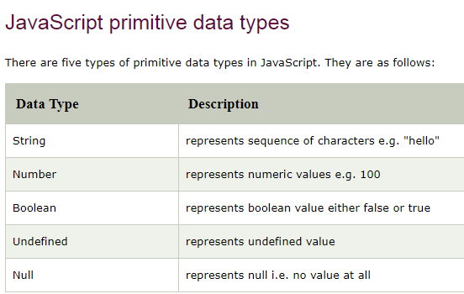

Slide 20
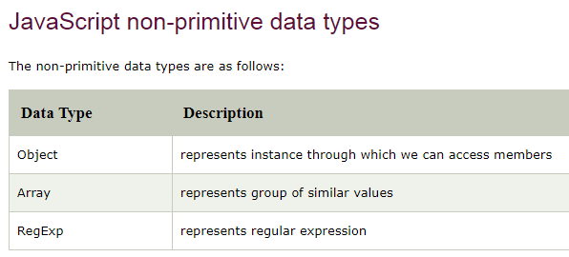

Slide 21
JavaScript Operators
JavaScript operators are symbols that are used to perform operations on operands. For example:
var sum=10+20;
Here, + is the arithmetic operator and = is the assignment operator.
There are following types of operators in JavaScript.
Arithmetic Operators
Comparison (Relational) Operators
Bitwise Operators
Logical Operators
Assignment Operators
Special Operators

Slide 22
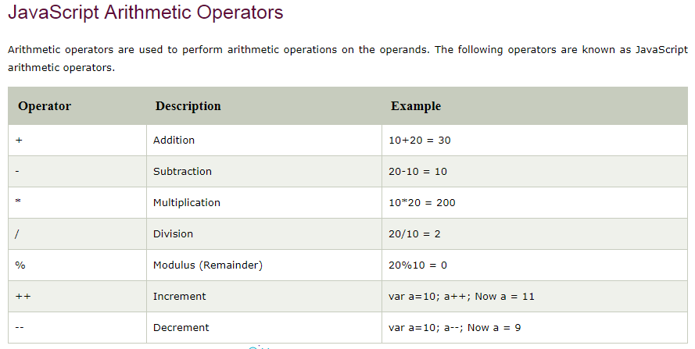

Slide 23
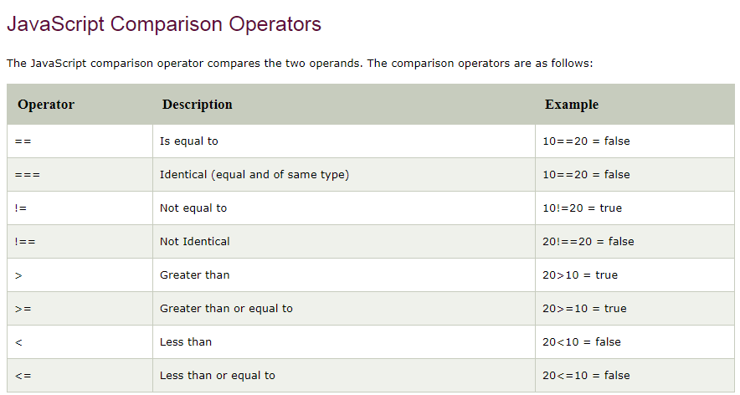

Slide 24
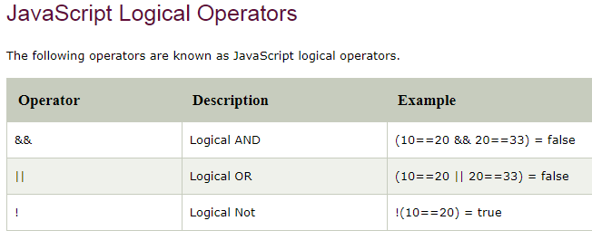

Slide 25
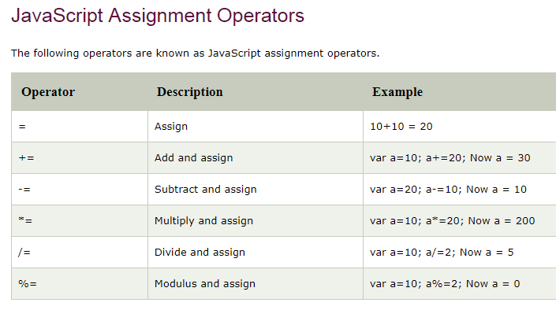


Slide 26
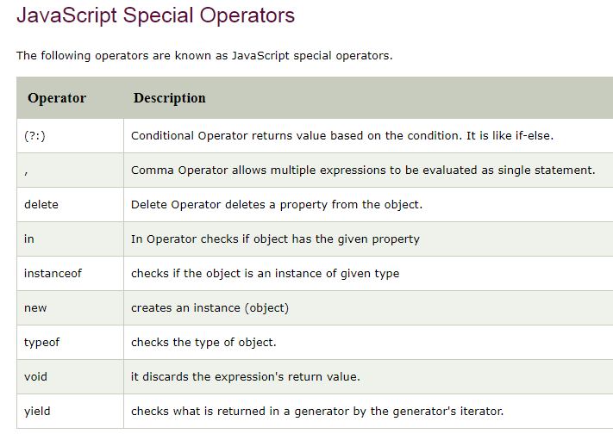

Slide 27
JavaScript If-else
The JavaScript if-else statement is used to execute the code whether condition is true or false. There are three forms of if statement in JavaScript.
If Statement
If else statement
if else if statement
JavaScript If statement
It evaluates the content only if expression is true. The signature of JavaScript if statement is given below.
if(expression){
//content to be evaluated
}

Slide 28
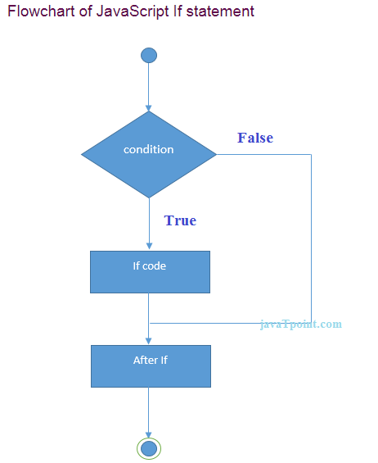

Slide 29
JavaScript If-else
Let’s see the simple example of if statement in javascript.
<script>
var a=20;
if(a>10){
document.write("value of a is greater than 10");
}
</script>
Output of the above example
value of a is greater than 10

Slide 30
JavaScript If...else Statement
It evaluates the content whether condition is true of false. The syntax of JavaScript if-else statement is given below.
if(expression){
//content to be evaluated if condition is true
}
else{
//content to be evaluated if condition is false
}

Slide 31
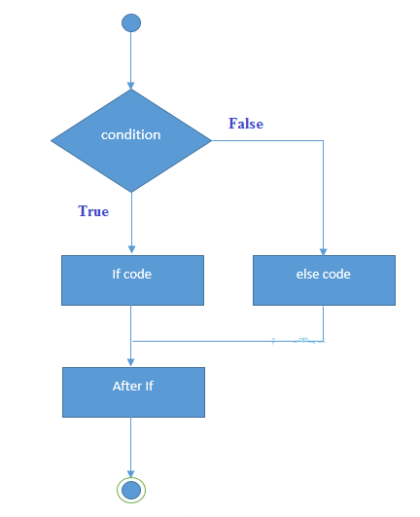

Slide 32
if...else statement
<html>
<body>
<script type="text/javascript">
<!--
var age = 15;
if( age > 18 ){
document.write("<b>Qualifies for driving</b>");
}
else{
document.write("<b>Does not qualify for driving</b>");
}
//-->
</script>
<p>Set the variable to different value and then try...</p>
</body>
</html>

Slide 33
if...else if... statement
The if...else if... statement is an advanced form of if…else that allows JavaScript to make a correct decision out of several conditions.
Syntax
The syntax of an if-else-if statement is as follows −
if (expression 1){
Statement(s) to be executed if expression 1 is true
}
else if (expression 2){
Statement(s) to be executed if expression 2 is true
}
else if (expression 3){
Statement(s) to be executed if expression 3 is true
}
else{
Statement(s) to be executed if no expression is true
}
There is nothing special about this code. It is just a series of if statements, where each if is a part of the else clause of the previous statement. Statement(s) are executed based on the true condition, if none of the conditions is true, then the else block is executed.

Slide 34
<html>
<body>
<script type="text/javascript">
<!--
var book = "maths";
if( book == "history" ){
document.write("<b>History Book</b>");
}
else if( book == "maths" ){
document.write("<b>Maths Book</b>");
}
else if( book == "economics" ){
document.write("<b>Economics Book</b>");
}
else{
document.write("<b>Unknown Book</b>");
}
//-->
</script>
<p>Set the variable to different value and then try...</p>
</body>
<html>

Slide 35
JavaScript – Switch case
You can use multiple if...else…if statements, as in the previous chapter, to perform a multiway branch. However, this is not always the best solution, especially when all of the branches depend on the value of a single variable.
Starting with JavaScript 1.2, you can use a switch statement which handles exactly this situation, and it does so more efficiently than repeated if...else if statements.

Slide 36
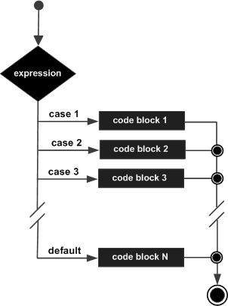

Slide 37
Syntax
The objective of a switch statement is to give an expression to evaluate and several different statements to execute based on the value of the expression. The interpreter checks each case against the value of the expression until a match is found. If nothing matches, a default condition will be used.
switch (expression)
{
case condition 1: statement(s)
break;
case condition 2: statement(s)
break;
...
case condition n: statement(s)
break;
default: statement(s)
}
The break statements indicate the end of a particular case. If they were omitted, the interpreter would continue executing each statement in each of the following cases.

Slide 38
<html>
<body>
<script type="text/javascript">
<!--
var grade='A';
document.write("Entering switch block<br />");
switch (grade)
{
case 'A': document.write("Good job<br />");
break;
case 'B': document.write("Pretty good<br />");
break;
case 'C': document.write("Passed<br />");
break;
case 'D': document.write("Not so good<br />");
break;
case 'F': document.write("Failed<br />");
break;
default: document.write("Unknown grade<br />")
}
document.write("Exiting switch block");
//-->
</script>
<p>Set the variable to different value and then try...</p>
</body>
</html>

Slide 39
Break statements play a major role in switch-case statements. Try the following code that uses switch-case statement without any break statement.
<html>
<body>
<script type="text/javascript">
<!--
var grade='A';
document.write("Entering switch block<br />");
switch (grade)
{
case 'A': document.write("Good job<br />");
case 'B': document.write("Pretty good<br />");
case 'C': document.write("Passed<br />");
case 'D': document.write("Not so good<br />");
case 'F': document.write("Failed<br />");
default: document.write("Unknown grade<br />")
}
document.write("Exiting switch block");
//-->
</script>
<p>Set the variable to different value and then try...</p>
</body>
</html>

Slide 40
JavaScript - While Loop
While writing a program, you may encounter a situation where you need to perform an action over and over again. In such situations, you would need to write loop statements to reduce the number of lines.
JavaScript supports all the necessary loops to ease down the pressure of programming.
The while Loop
The most basic loop in JavaScript is the while loop which would be discussed in this chapter. The purpose of a while loop is to execute a statement or code block repeatedly as long as an expression is true. Once the expression becomes false, the loop terminates.

Slide 41
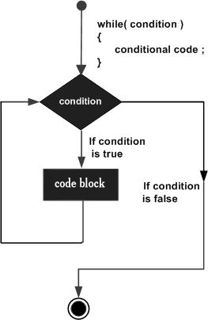

Slide 42
Syntax
The syntax of while loop in JavaScript is as follows −
while (expression){
Statement(s) to be executed if expression is true
}
<html>
<body>
<script type="text/javascript">
<!--
var count = 0;
document.write("Starting Loop ");
while (count < 10){
document.write("Current Count : " + count + "<br />");
count++;
}
document.write("Loop stopped!");
//-->
</script>
<p>Set variable to different value and then try...</p>
</body>
</html>

Slide 43
do...while Loop
The do...while loop is similar to the while loop except that the condition check happens at the end of the loop. This means that the loop will always be executed at least once, even if the condition is false.
Syntax
The syntax for do-while loop in JavaScript is as follows −
do{
Statement(s) to be executed;
} while (expression);
Note − Don’t miss the semicolon used at the end of the do...while loop.

Slide 44
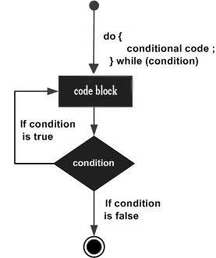

Slide 45
<html>
<body>
<script type="text/javascript">
<!--
var count = 0;
document.write("Starting Loop" + "<br />");
do{
document.write("Current Count : " + count + "<br />");
count++;
}
while (count < 5);
document.write ("Loop stopped!");
//-->
</script>
<p>Set the variable to different value and then try...</p>
</body>
</html>

Slide 46
JavaScript - For Loop
The 'for' loop is the most compact form of looping. It includes the following three important parts −
The loop initialization where we initialize our counter to a starting value. The initialization statement is executed before the loop begins.
The test statement which will test if a given condition is true or not. If the condition is true, then the code given inside the loop will be executed, otherwise the control will come out of the loop.
The iteration statement where you can increase or decrease your counter.
You can put all the three parts in a single line separated by semicolons.
Syntax
The syntax of for loop is JavaScript is as follows −
for (initialization; test condition; iteration statement){
Statement(s) to be executed if test condition is true
}

Slide 47
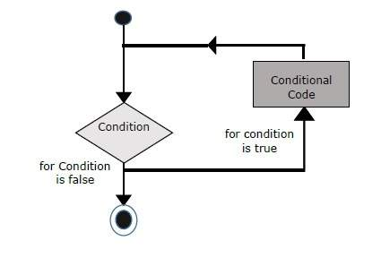

Slide 48
<html>
<body>
<script type="text/javascript">
<!--
var count;
document.write("Starting Loop" + "<br />");
for(count = 0; count < 10; count++){
document.write("Current Count : " + count );
document.write("<br />");
}
document.write("Loop stopped!");
//-->
</script>
<p>Set the variable to different value and then try...</p>
</body>
</html>

Slide 49
JavaScript for...in loop
The for...in loop is used to loop through an object's properties. As we have not discussed Objects yet, you may not feel comfortable with this loop. But once you understand how objects behave in JavaScript, you will find this loop very useful.
Syntax
for (variablename in object){
statement or block to execute
}
In each iteration, one property from object is assigned to variablename and this loop continues till all the properties of the object are exhausted.

Slide 50
Example to implement ‘for-in’ loop. It prints the web browser’s Navigator object.
<html>
<body>
<script type="text/javascript">
<!--
var aProperty;
document.write("Navigator Object Properties<br /> ");
for (aProperty in navigator) {
document.write(aProperty);
document.write("<br />");
}
document.write ("Exiting from the loop!");
//-->
</script>
<p>Set the variable to different object and then try...</p>
</body>
</html>

Slide 51
JavaScript Break statement
JavaScript provides full control to handle loops and switch statements. There may be a situation when you need to come out of a loop without reaching its bottom. There may also be a situation when you want to skip a part of your code block and start the next iteration of the loop.
To handle all such situations, JavaScript provides break and continue statements. These statements are used to immediately come out of any loop or to start the next iteration of any loop respectively.
The break Statement
The break statement, which was briefly introduced with the switch statement, is used to exit a loop early, breaking out of the enclosing curly braces.

Slide 52
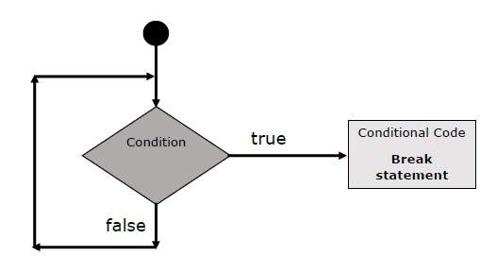

Slide 53
The following example illustrates the use of a break statement with a while loop. Notice how the loop breaks out early once x reaches 5 and reaches to document.write (..) statement just below to the closing curly brace −
<html>
<body>
<script type="text/javascript">
<!--
var x = 1;
document.write("Entering the loop<br /> ");
while (x < 20)
{
if (x == 5){
break; // breaks out of loop completely
}
x = x + 1;
document.write( x + "<br />");
}
document.write("Exiting the loop!<br /> ");
//-->
</script>
<p>Set the variable to different value and then try...</p>
</body>
</html>

Slide 54
The continue Statement
The continue statement tells the interpreter to immediately start the next iteration of the loop and skip the remaining code block. When a continue statement is encountered, the program flow moves to the loop check expression immediately and if the condition remains true, then it starts the next iteration, otherwise the control comes out of the loop.
<html>
<body>
<script type="text/javascript">
<!--
var x = 1;
document.write("Entering the loop<br /> ");
while (x < 10)
{
x = x + 1;
if (x == 5){
continue; // skip rest of the loop body
}
document.write( x + "<br />");
}
document.write("Exiting the loop!<br /> ");
//-->
</script>
<p>Set the variable to different value and then try...</p>
</body>
</html>

Slide 55
JavaScript - Functions
A function is a group of reusable code which can be called anywhere in your program. This eliminates the need of writing the same code again and again. It helps programmers in writing modular codes. Functions allow a programmer to divide a big program into a number of small and manageable functions.
Like any other advanced programming language, JavaScript also supports all the features necessary to write modular code using functions. You must have seen functions like alert() and write() in the earlier chapters. We were using these functions again and again, but they had been written in core JavaScript only once.
JavaScript allows us to write our own functions as well. This section explains how to write your own functions in JavaScript.
Function Definition
Before we use a function, we need to define it. The most common way to define a function in JavaScript is by using the function keyword, followed by a unique function name, a list of parameters (that might be empty), and a statement block surrounded by curly braces.
The basic syntax is shown here.
<script type="text/javascript">
<!--
function functionname(parameter-list)
{
statements
}
//-->
</script>

Slide 56
Example
Try the following example. It defines a function called sayHello that takes no parameters −
<script type="text/javascript">
<!--
function sayHello()
{
alert("Hello there");
}
//-->
</script>
Calling a Function
To invoke a function somewhere later in the script, you would simply need to write the name of that function as shown in the following code.
<html>
<head>
<script type="text/javascript">
function sayHello() {
document.write ("Hello there!");
}
</script>
</head>
<body>
<p>Click the following button to call the function</p>
<form>
<input type="button" onclick="sayHello()" value="Say Hello">
</form>
<p>Use different text in write method and then try...</p>
</body>
</html>

Slide 57
Function Parameters
Till now, we have seen functions without parameters. But there is a facility to pass different parameters while calling a function. These passed parameters can be captured inside the function and any manipulation can be done over those parameters. A function can take multiple parameters separated by comma.
We have modified our sayHello function here. Now it takes two parameters.
<html>
<head>
<script type="text/javascript">
function sayHello(name, age) {
document.write (name + " is " + age + " years old.");
}
</script>
</head>
<body>
<p>Click the following button to call the function</p>
<form>
<input type="button" onclick="sayHello('Zara', 7)" value="Say Hello">
</form>
<p>Use different parameters inside the function and then try...</p>
</body>
</html>

Slide 58
The return Statement
A JavaScript function can have an optional return statement. This is required if you want to return a value from a function. This statement should be the last statement in a function.
For example, you can pass two numbers in a function and then you can expect the function to return their multiplication in your calling program.
It defines a function that takes two parameters and concatenates them before returning the resultant in the calling program.
<html>
<head>
<script type="text/javascript">
function concatenate(first, last) {
var full;
full = first + last;
return full;
}
function secondFunction() {
var result;
result = concatenate('Zara', 'Ali');
document.write (result );
}
</script>
</head>
<body>
<p>Click the following button to call the function</p>
<form>
<input type="button" onclick="secondFunction()" value="Call Function">
</form>
<p>Use different parameters inside the function and then try...</p>
</body>
</html>

